Slide 1
Meeting Week 17
Last week summary
Parameter recovery – adding parameters together
Augmentation
Outline ToDo next week

Slide 2
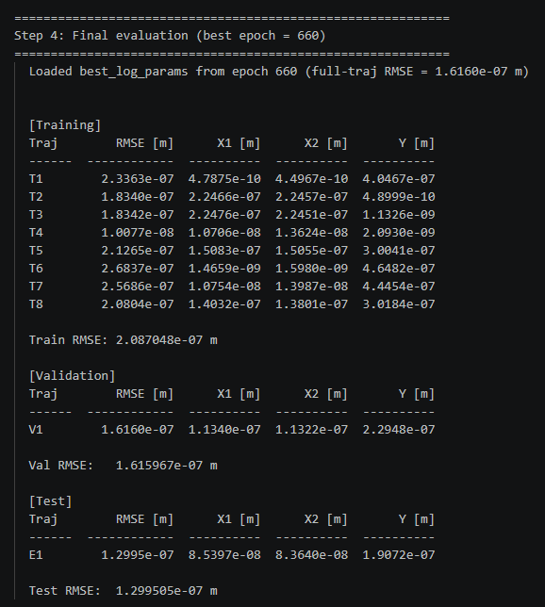
Trajectory – parameter recovery
Out of 1500 epochs, best validation RMSE for epoch 660

Slide 3
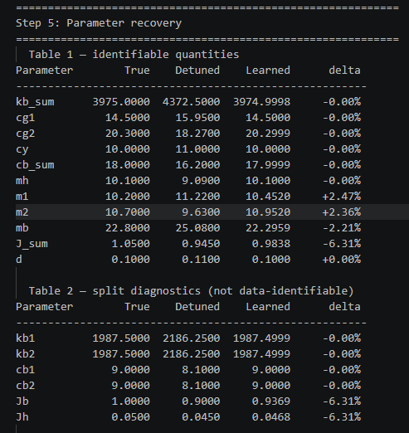
Trajectory – parameter recovery
Mainly J_sum
m1, m2 and mb

Slide 4
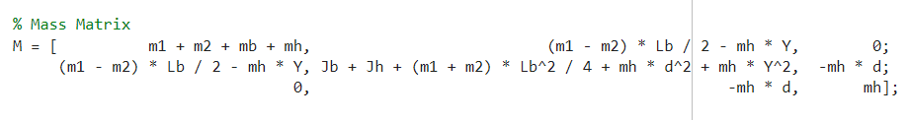
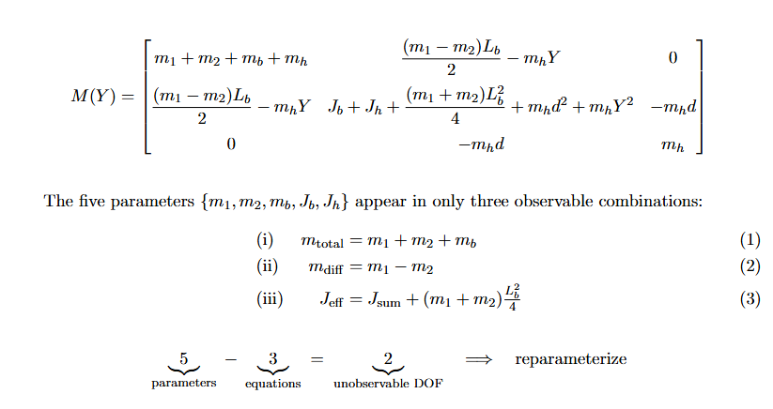

Trajectory – parameter recovery
If we sum the matrix indexes they match the true parameters exactly
But current problem: the individual parameters cannot be identified

Slide 6
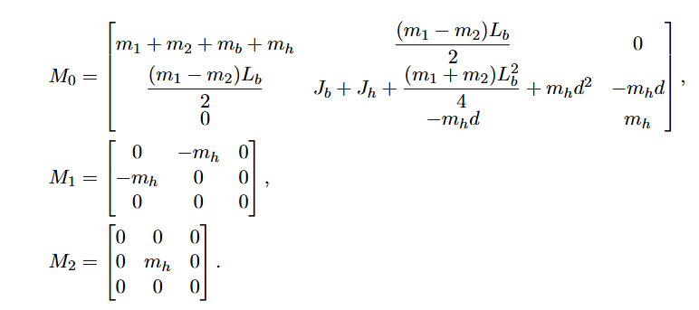
Print additional table for each matrix index

Slide 7
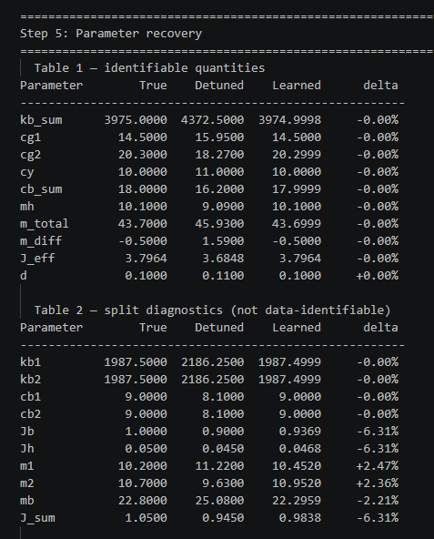
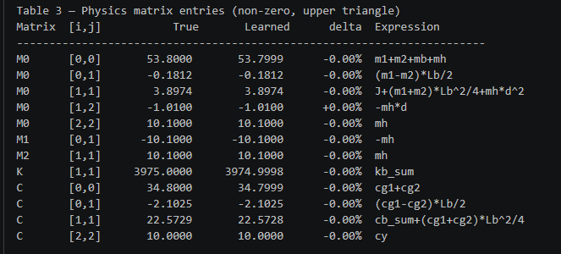

Slide 8
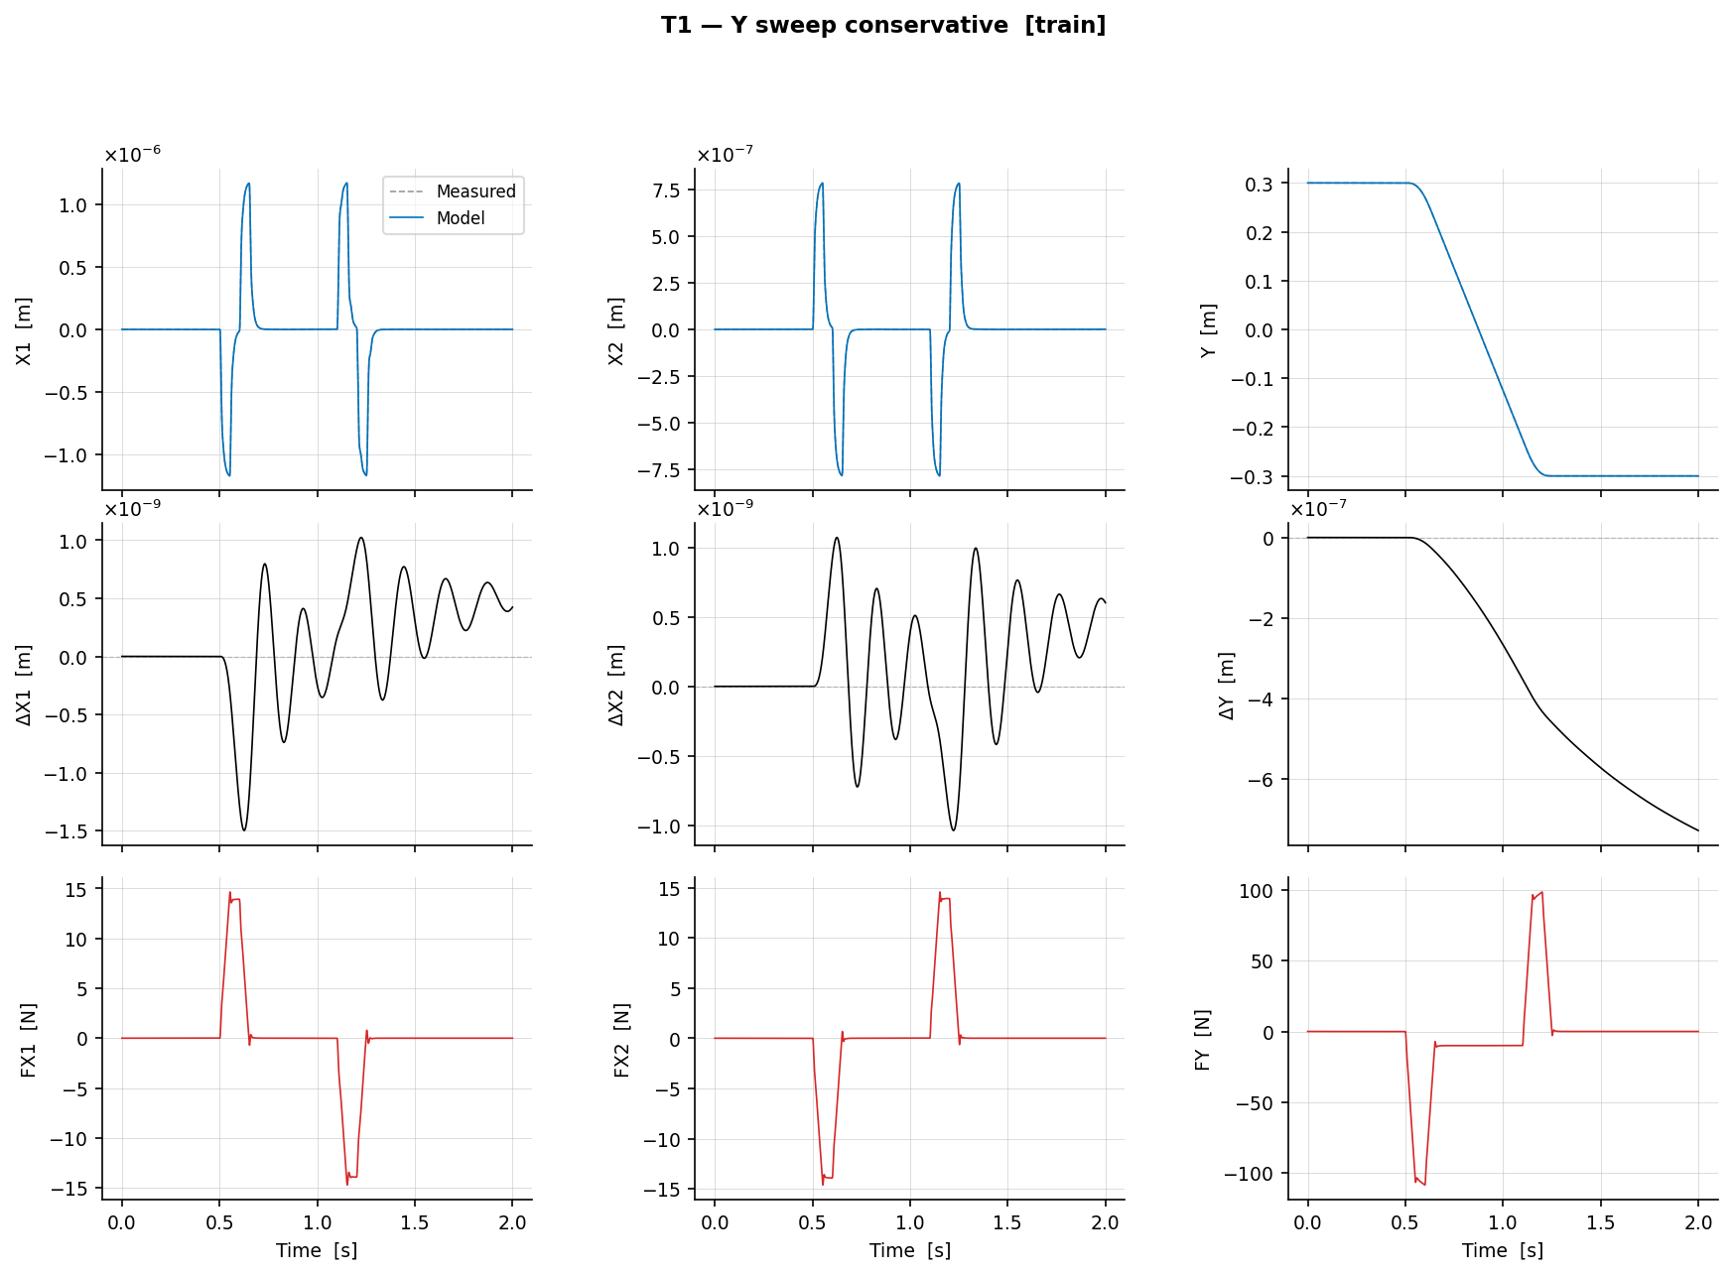
T1 – Y sweep conservative (training set)

Slide 9
Trajectories + multisine
Without multisine perfect recovery
  No reason for multisine at the moment
Instead need to move on to augmenation

Slide 10
Current augmentation methods
Different methods
Benefits of different methods
Which dynamica do we want to model

Slide 11
Unmodeled dynamics
(Dual) Gantry - ASMPT
Coupling most important. See meeting notes txt files if something useful has come up
Vereisten vanuit ASMPT
  Augmentation: want to capture unmodeled dynamics, expect this to be …. And capturing the coupling is most important
  Cross-coupling between X and Y axes, and between the two gantries. Important for settling error and prediction accuracy. Currently not fully captured.
  flexible dynamics are the most important unmodeled effect.
  Nonlinearities (for example actuator not fully linear?)
  Cogging and friction are partially handled already by firmware: not the primary augmentation target.
  the flexible/structural effects are hard to model because they are strongly coupled and structurally complex. The rigid-body FP model captures translation and rotation as rigid degrees of freedom. The flexible modes require extra states (the spring-mass-damper modes) that do not exist in the rigid-body state vector — they are hidden, not directly observable.

Slide 12
Explain static and dynamic and then series and parallel for both

Slide 13
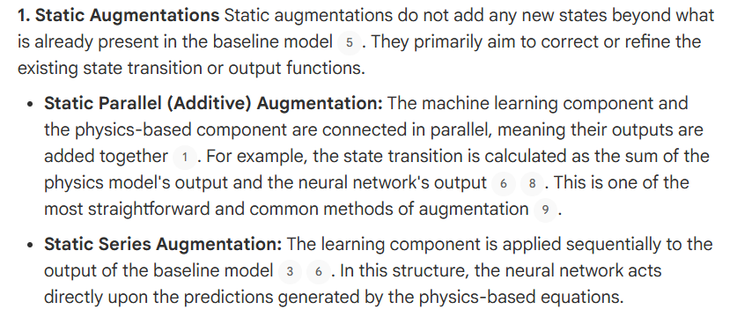
1. Static parallel: adds a correction directly to the state transition, taking the same inputs as the FP model. No extra states
2. Static series
3. Dynamic parallel
4. Dynamic series

Slide 14
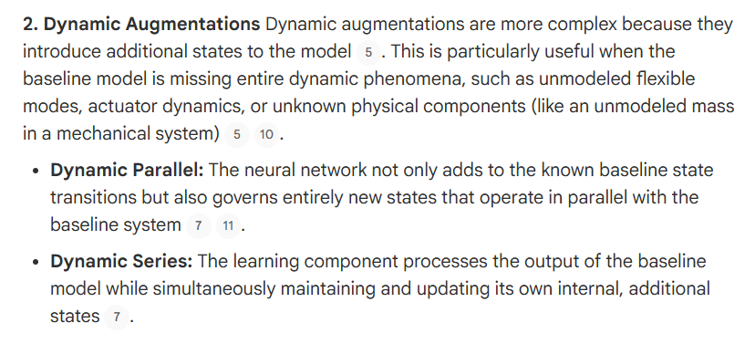

Slide 15
Orthogonality
What the orthogonality paper adds (Györök et al. 2025)
This paper focuses exclusively on static parallel / additive augmentation
The solution: orthogonal projection regularization

Slide 16
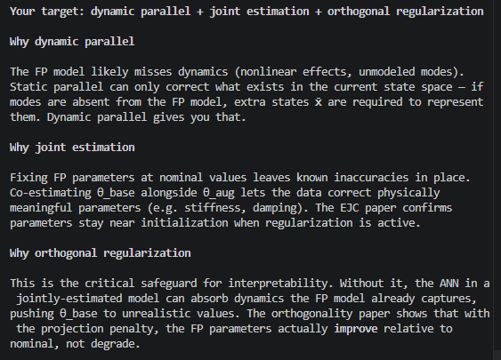
Your target: dynamic parallel + joint estimation + orthogonal regularization

Slide 17
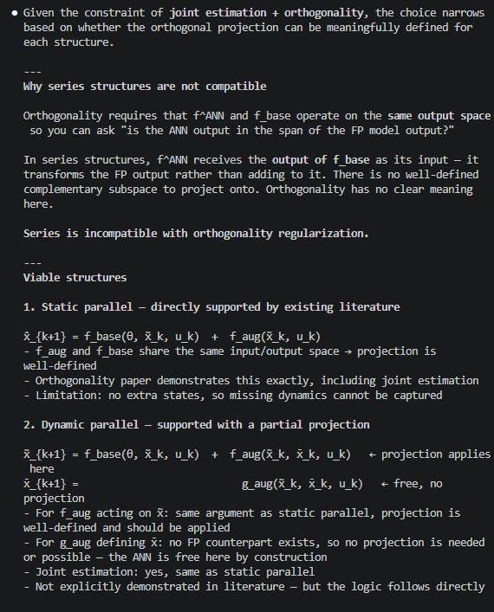

Slide 18
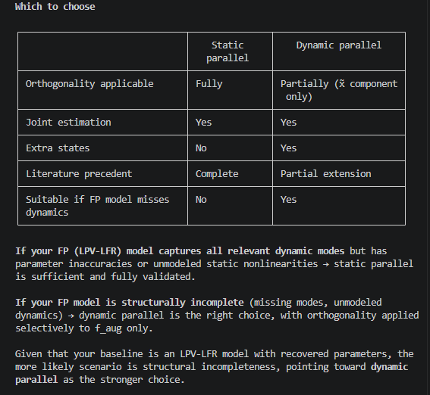

Slide 19
Augmentation
Additional state
Want it to be physically meaningful / if I add dynamics (MSD) the formulas need to be correct – ASMPT

Slide 20
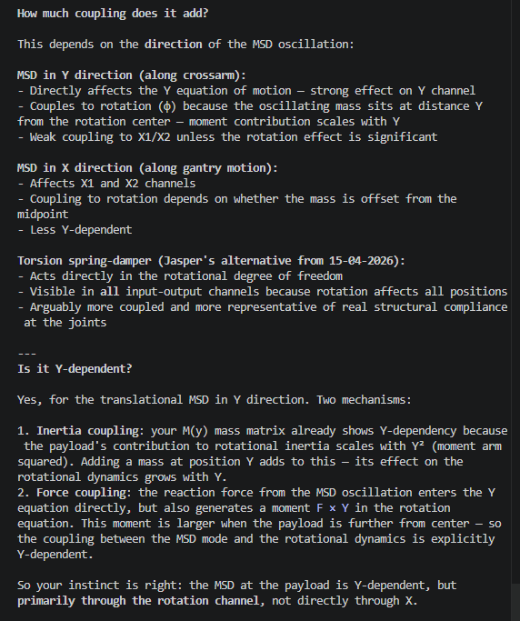
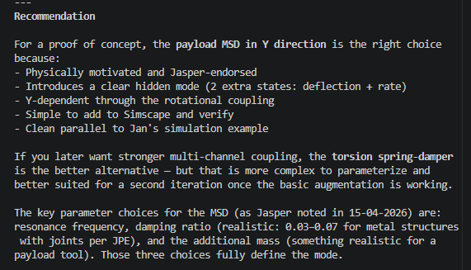
Augmentation
Additional state
o

Slide 21
Do I add the total payload mass and then the augmentation has to “find” the two masses (MSD attached)

Slide 22
Validation
Simulink
Does the augmentation show up in the FRF?:
I dont know how to classify this. I think I'll have to compare the FRFs of the two
or rms or some metric to determine whether the augmentation is valid
What does an MSD add to the dynamics? what do we expect to see in addition due to the MSD?
(- The difference should show a clear resonance bump at omega_n / (2*pi) ≈ 3.6 Hz
- If the bump is barely above the noise floor the fraction is too small)
Notes:
Why ka=500, ca=2? Is it reasonable?
These came from the context prompt (Jasper's guidance), not my own choice. The
reasoning was:
- omega_n = sqrt(ka/ma) = sqrt(500/1.01) ≈ 22.2 rad/s ≈ 3.54 Hz — places the
resonance within the setpoint bandwidth so it gets excited by the step trajectory
- zeta = ca / (2*sqrt(ka*ma)) = 2 / (2*sqrt(500*1.01)) ≈ 0.045 — within Jasper's JPE
damping range 0.03–0.07
How to frame it to supervisors: the FRF is not a research contribution — it is
evidence that the simulation PoC is a valid test. Without it, a reviewer can always
ask "how do you know the hidden dynamics were actually excited?" The FRF closes that
question.
If supervisors still push back, the counter-question is: what would they accept as
evidence that the simulation PoC is a fair test of the augmentation?

Slide 23
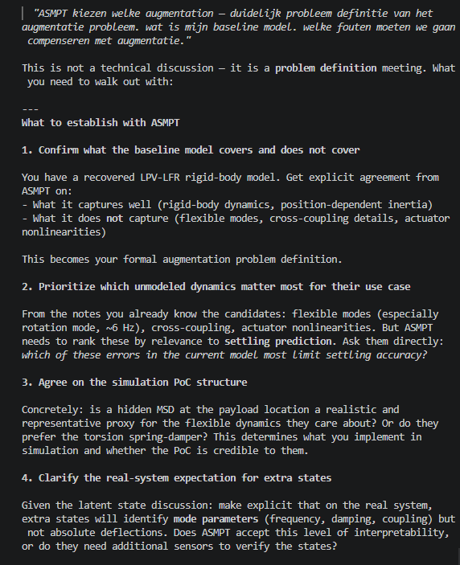
Establish with ASMPT

Slide 24
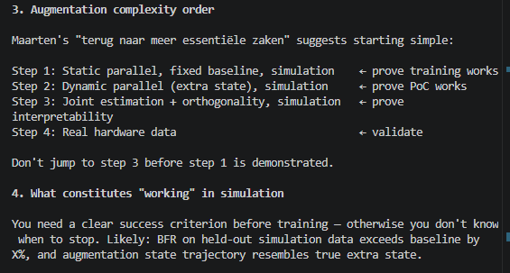
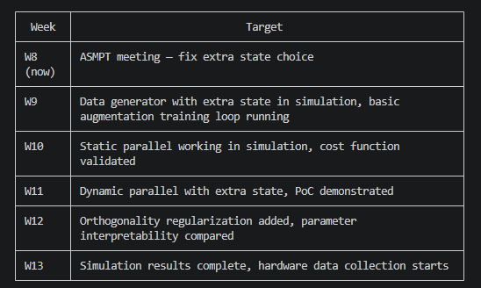
High level planning next month
Augmentation
First joint without orthogonality? Maybe first choose a simpler structure, maybe just extra work

Slide 25
Augmentation
Adding MSD to the baseline model
Verify with simscape

Slide 26


Slide 27


Slide 28

Lagrange-Euler - Garcia

Slide 29

Lagrange-Euler - Garcia

Slide 30
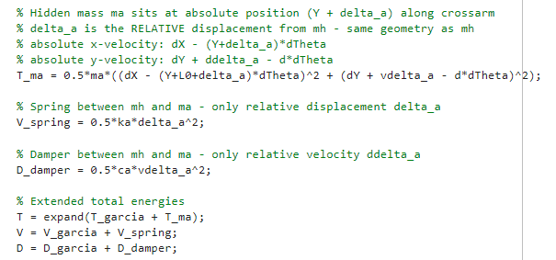
Lagrange-Euler – Additional state
Only added offset L0

Slide 31
=== Extended model RMSE vs Simscape ===
RMSE X1 : 2.4919e-07 m
RMSE X2 : 1.6463e-07 m
RMSE Y : 5.0275e-09 m
=== Baseline model RMSE vs Simscape ===
RMSE X1 : 4.4957e-07 m
RMSE X2 : 2.9607e-07 m
RMSE Y : 7.6171e-09 m

Slide 32
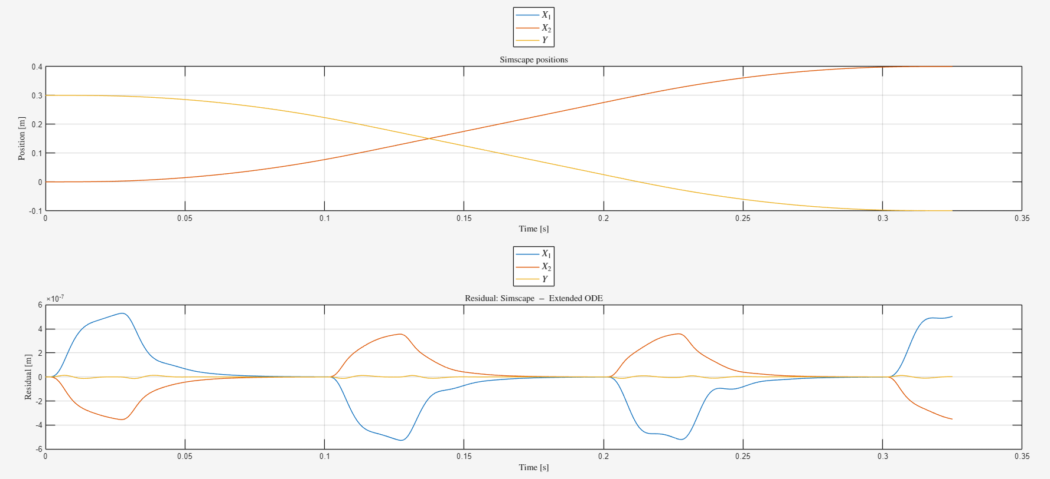

Slide 33
=== Additional state delta_a (extended ODE vs Simscape) ===
RMSE delta_a : 2.1787e-10 m

Slide 34
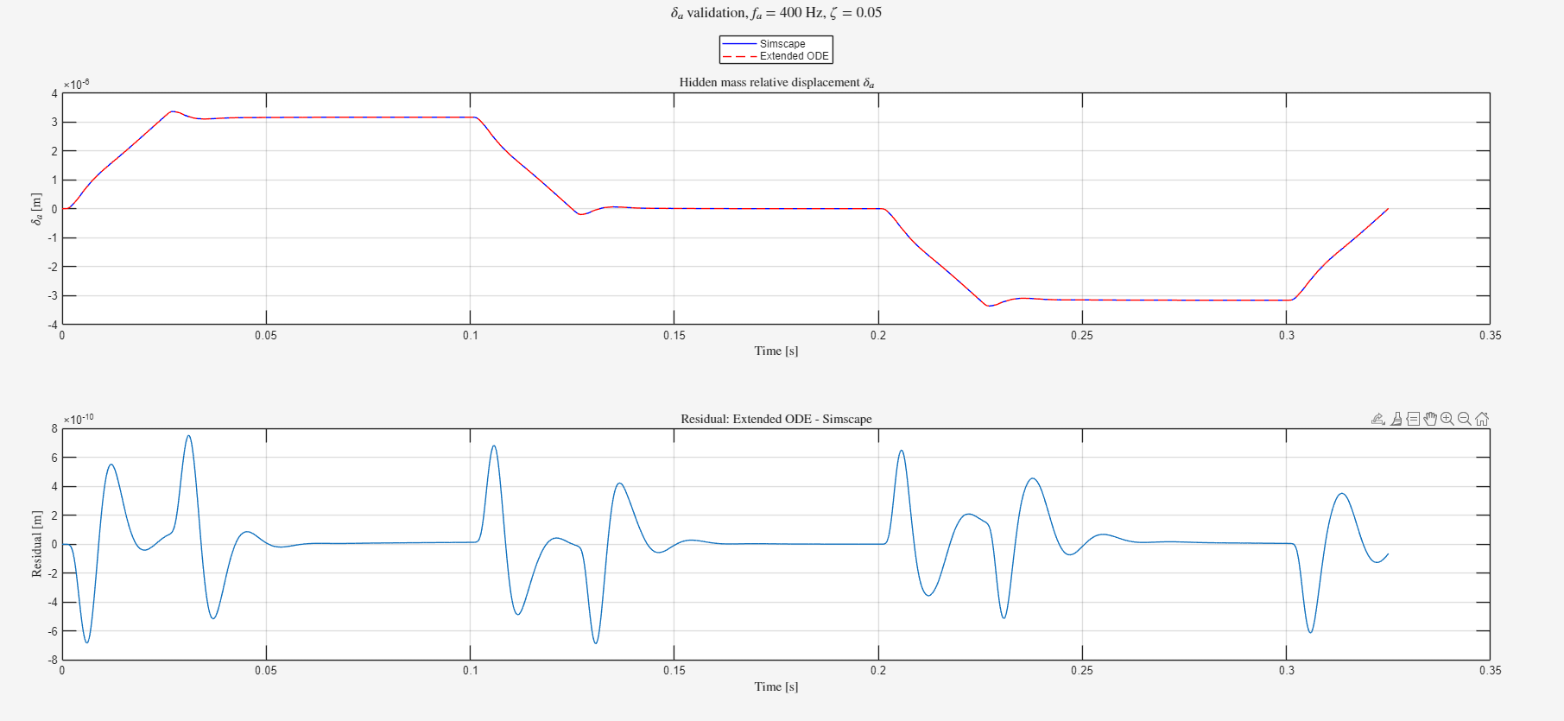

Slide 35
Both without augmenatation
=== Baseline model RMSE vs Simscape ===
RMSE X1 : 5.7487e-09 m
RMSE X2 : 4.3737e-09 m
RMSE Y : 8.8062e-10 m

Slide 36
Outline next week
Planning for augmentation next month
  Clear outline of what goals to achieve for augmentation (main headings)
Work on implementing Jan’s augmentation structure
  First without joint estimation → parameters of the baseline model are kept constant

Slide 37
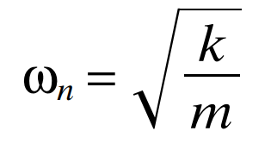
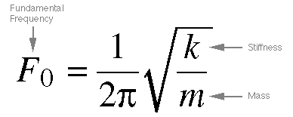
Frequency
400 hz range kijken met massa en spring stiffness → meer realistisch dan in de 27 hz range als ik die nog niet gevonden zou hebben.
Formule jasper gebruiken voor damping coefficient bepalen: Meestal percentage
Offset middelpunt zelfde maken als formules (R)
ka = 1.01 * (2π * 400)² ≈ 6.38 × 10⁶ N/m

Slide 38
Choices:
- Target frequency: f_a = 400 Hz
- Damping ratio: zeta = 0.05 (metal structures with joints, range 0.03-0.07)
Calculated:
k_a = m_a * (2pif_a)^2 = 1.01 * (2pi400)^2 ≈ 6.38e6 N/m
c_a = 2 * zeta * sqrt(k_a * m_a) = 2 * 0.05 * sqrt(6.38e6 * 1.01) ≈ 254 Ns/m

Slide 39
Determining stiffness and damping coefficient
https://www.jpe-innovations.com/precision-point/structural-damping-properties-mechanical-systems/
Formula stiffness circa 200-400 hz (choose 400) but coupled system, so will have to see how it affects.
For damping choose Metal structures with joints 0.03 - 0.07

Slide 40
Note:
Picture is not fully accurate, we define the mass as the relative displacement from mh currently
Will need to add offset

